Slide 1
Asset Naming Convention
Asset Number - Create combining Zone, Location bldg. # (ie.298), Acronym from sub-system list and 01,02 etc. Use all CAPS
MYP-298-TOI-01
Zone bldg.# Acronym Item #
This asset number represents ALL Toilets in bldg. 298.
Always start the Items #s with 01. If there are more than one item per sub-system in a bldg. then use 02,03 etc. Example:
FLUORECENT INTERIOR LIGHTING - MYP-298-ILG-01
LED INTERIOR LIGHTING, SUSPENDED - MYP-298-ILG-02

Slide 2
Asset Naming Convention (Special Areas)
PAN-TA-1-TOI-01
Zone - Special Area - Bldg. # - Acronym - Item #
Asset Number - Create combining Zone, Special Area Code, Location bldg. # (ie.298), Acronym from sub-system list and 01,02 etc. Use all CAPS
Special Area list located in NAVFAC SE ICAP DESK GUIDE 2014.

Slide 3
Acronym List
The list was created with multiple uses in mind. It standardizes: acronyms, asset descriptions, and to determine if the asset is Dynamic or Non-Dynamic.
SUBSYSTEM | UOM | SUBSYSTEM - EXISTING/NEW | MAXIMO DECRIPTION | NON-DYNAMIC
STANDARD FOUNDATIONS |  |  |  | NON-DYNAMIC
A1010105 - WALL FOUNDATIONS | SF | SWF | WALL FOUNDATIONS | NON-DYNAMIC
A1010110 - STRIP FOOTINGS | LF | SFF | STRIP FOOTINGS | NON-DYNAMIC
A1010210 - SPREAD FOOTINGS | EA | FSF | SPREAD FOOTINGS | NON-DYNAMIC | SYSTEM
A1010230 - COLUMN PIER | EA | SCC | COLUMN PIER, COMCRETE | NON-DYNAMIC | ORIGINAL SUB-SYSTEM
A1010230 - COLUMN PIER | EA | SCC | COLUMN PIER, STEEL | NON-DYNAMIC | NEW SUB-SYSTEM
A1010230 - COLUMN PIER | EA | SCW | COLUMN PIER, WOOD | NON-DYNAMIC
A1010250 - PILE CAPS | EA | FPC | PILE CAPS | NON-DYNAMIC | DESCRIPTIONS LOCATION EXAMPLES
A1010999 - OTHER | EA | FND |  | NON-DYNAMIC | NORTH, SOUTH, EAST, WEST
SPECIAL FOUNDATIONS |  |  |  | NON-DYNAMIC | BUILDINGWIDE, 1FL, 2FL, RM ###
A1020005 - RAFT FOUNDATIONS | CY | SRF | RAFT FOUNDATIONS | NON-DYNAMIC
A1020110 - CIP CONCRETE PILES | EA | SCP | CIP CONCRETE PILES | NON-DYNAMIC | DESCRIPTION UNIT OF MEASURE
A1020120 - PRECAST CONCRETE PILES | EA | PCP | PRECAST CONCRETE PILES | NON-DYNAMIC | MBH = THOUSANT BTU'S PER HOUR
A1020130 - STEEL PIPE PILES | EA | SPP | STEEL PIPE PILES | NON-DYNAMIC | BTU = BRITISH THEMAL UNIT
A1020140 - STEEL H PILES | EA | SHP | STEEL H PILES | NON-DYNAMIC | GAL = GALLONS
A1020160 - TREATED WOOD PILES | EA | TWP | TREATED WOOD PILES | NON-DYNAMIC | AMP = AMPERE
A1020210 - GRADE BEAMS | LF | FGB | GRADE BEAMS | NON-DYNAMIC | HP = HORSEPOWER
A1020810 - CONCRETE EQUIPMENT FOUNDATION | SF | SCT | CONCRETE EQUIPMENT FOUNDATION | NON-DYNAMIC | KVA = 1,000 VOLT AMPS
A1020999 - OTHER | EA | SFO | SPECIAL FOUNDATION | NON-DYNAMIC
SLAB ON GRADE |  |  |  | NON-DYNAMIC
A1030120 - PLAIN/REINFORCED | SF | PRS | PLAIN/REINFORCED 6" SLAB DEPTH | NON-DYNAMIC
A1030999 - OTHER | SF | SOG |  | NON-DYNAMIC
BASEMENT CONSTRUCTION |  |  |  | NON-DYNAMIC
A2010999 - OTHER BASEMENT EXCAVATION | CY | BCE | OTHER BASEMENT EXCAVATION | NON-DYNAMIC
A2020110 - CIP CONCRETE | LF | BWC | CIP CONCRETE, FOUNDATION | NON-DYNAMIC
A2020140 - CONCRETE BLOCK | LF | BWB | CONCRETE BLOCK, BASEMENT WALL | NON-DYNAMIC

Slide 4
Essential information required for assets in MAXIMO cont.
Inventory Categories
A Component Inventory Management Unit (CIMU) contains a large non-dynamic component (e.g. 50,000 sqft of floor covering or 200 ea. lighting fixtures) OR is a group of dynamic equipment (e.g. 6 ea. air handling units) that share the same UNIFORMAT classification, was installed at approximately the same time, and can be expected to follow a similar life cycle degradation. A CIMU is the consolidation of similar components/equipment into a single management unit.
A Real Property Installed Equipment (RPIE) is an item of equipment that is affixed and built into a facility as an integral part of that facility. To qualify as RPIE, the equipment must be necessary to make the facility complete, and if removed, would destroy or severely reduce the designed usefulness and operation of the facility. RPIE included such items as control systems, heating, cooling, electrical, emergency lighting, etc. Individual pieces of like equipment (RPIE) are grouped into CIMUs. Condition is managed at the CIMU level, not at the RPIE level.
BOTH is a single, stand-alone piece of equipment (RPIE) that is managed independently and therefore is both a CIMU and an RPIE. Typical examples are larger, more expensive RPIE with longer design lives such as chillers, boilers, elevators, etc.

Slide 5
Essential information required for assets in MAXIMO cont.
A Component Inventory Management Unit (CIMU) contains a large non-dynamic component (e.g. 50,000 sqft of floor covering or 200 ea. lighting fixtures) OR is a group of dynamic equipment (e.g. 6 ea. air handling units) that share the same UNIFORMAT classification, was installed at approximately the same time, and can be expected to follow a similar life cycle degradation. A CIMU is the consolidation of similar components/equipment into a single management unit.

Slide 6
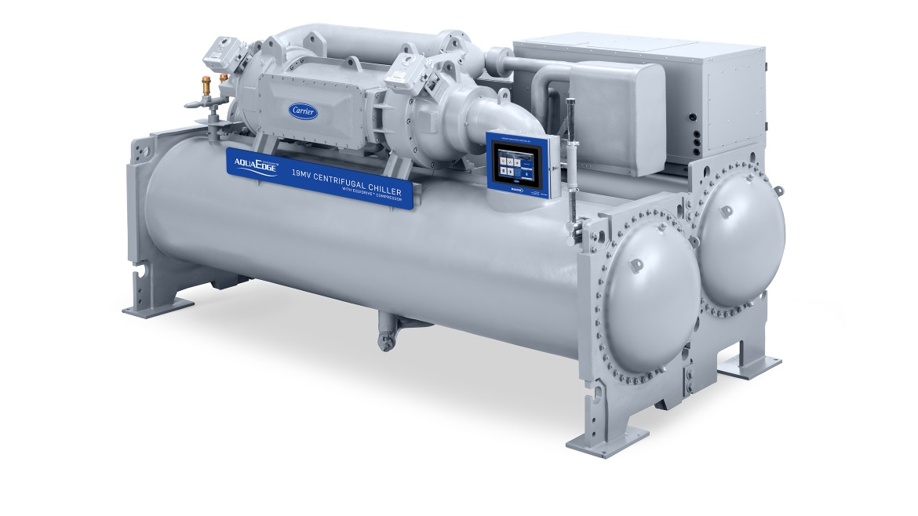
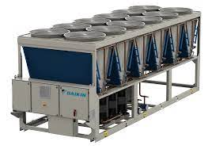
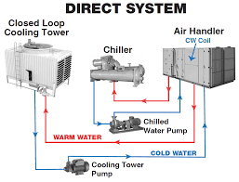
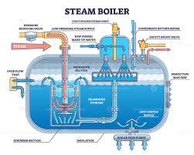
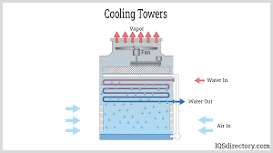
Essential information required for assets in MAXIMO cont.
BOTH is a single, stand-alone piece of equipment (RPIE) that is managed independently and therefore is both a CIMU and an RPIE. Typical examples are larger, more expensive RPIE with longer design lives such as chillers, boilers, elevators, etc.

Slide 7
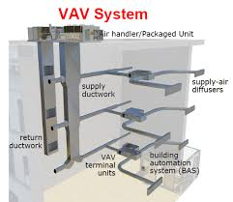
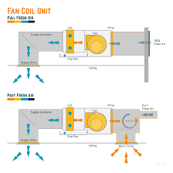
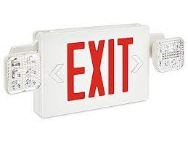
Essential information required for assets in MAXIMO cont.
A Real Property Installed Equipment (RPIE) is an item of equipment that is affixed and built into a facility as an integral part of that facility. To qualify as RPIE, the equipment must be necessary to make the facility complete, and if removed, would destroy or severely reduce the designed usefulness and operation of the facility. RPIE included such items as control systems, heating, cooling, electrical, emergency lighting, etc. Individual pieces of like equipment (RPIE) are grouped into CIMUs. Condition is managed at the CIMU level, not at the RPIE level.

Slide 8
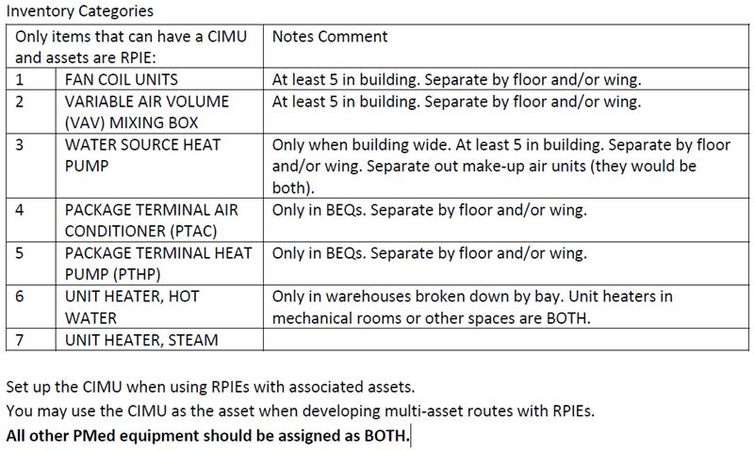
Essential information required for assets in MAXIMO cont.

Slide 9
Example of CIMU, RPIE & BOTH
HVAC System

Slide 10
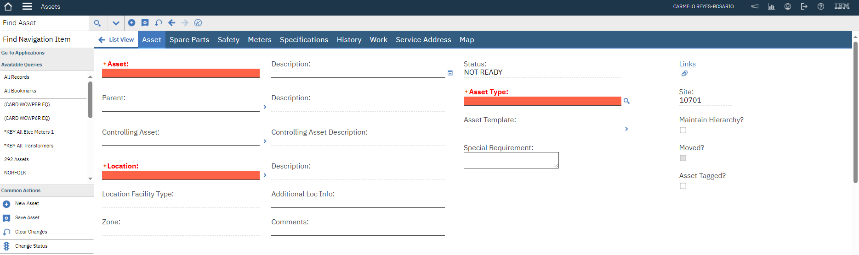
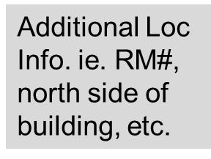
Helpful Information for assets in MAXIMO
Click here to add any additional info.
Special Requirement for any characteristics out of the ordinary
Comments are required when DCR is less than G- (88)

